Slide 1
Experiments
Doing Political Research

Slide 2
Observational and Experimental Research
Observational studies
We observe subjects (people, institutions, regions etc) without controlling the independent variable, which is not randomly assigned
Experimental studies
We control and randomly assign values of the independent variable to the subjects
Natural experiments
The independent variable is randomly assigned by some form of ‘natural’ process

Slide 3
Why Experiment?
Observational studies have problems with endogeneity
Does X cause Y, Y cause X or Z cause X and Y?
For example, how does the newspaper you read affect your vote choice?
Experimental studies help us to make causal inferences by randomising who gets the ‘treatment’ (the independent variable)
But experiments are only suitable for certain types of projects and must be designed very carefully

Slide 4
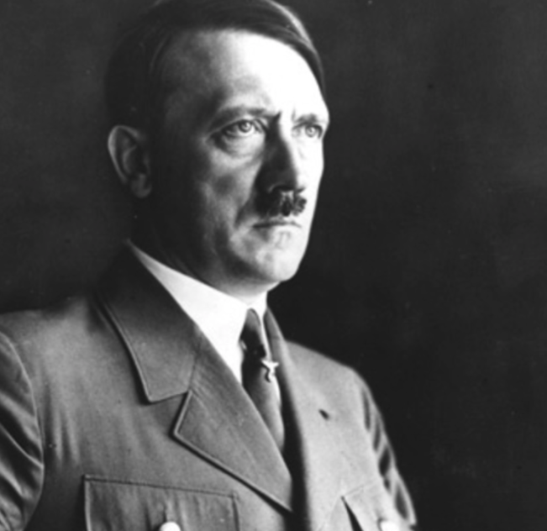
An Early Political Research Experiment
In 1940, Hadley Cantril asked c3000 Americans either:
Do you think the U.S. should do more than it is now doing to help England and France in the fight against Hitler?
The ‘Hitler effect’ was 22% - 13% = 9% points
Do you think the U.S. should do more than it is now doing to help England and France?
22% said Yes
13% said Yes

Slide 5
The Rise of Experiments in Political Research (Druckman 2022)

Slide 6
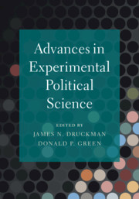
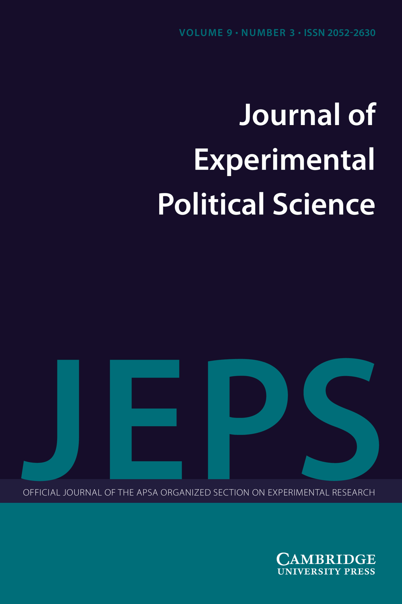
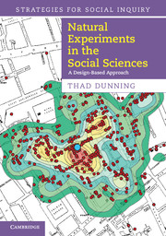
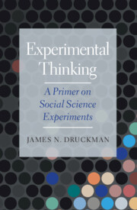
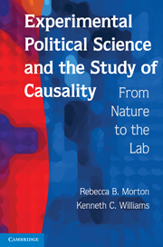
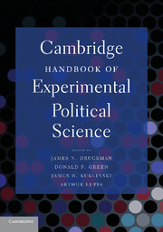
Why the Rise in Experiments?
Increased computing power
Easier to find participants through mobile phones, the internet etc
Methodological developments and shared standards for experimental research
Improved research infrastructure

Slide 7
Types of Experiment
Lab
Survey
Field
Natural

Slide 8
Lab Experiments
You invite a group of people to play a game or simulation
The rules, set-up or types of players are varied randomly to see how they effect the outcomes of the game
For example, the Dictator Game
one player is given a sum of money and can choose to divide it between themselves and another player in any way they want
the other player can either accept the division and keep the money allocated or reject the division, in which case neither player keeps the money
can be varied in terms of who the players are, how much money is given, whether the players are observed, how many rounds are played
Lab-in-the-field experiments: conduct the game in the community in a more realistic setting

Slide 9
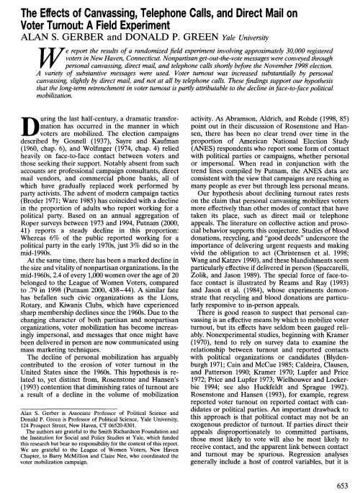
Field Experiment
Experiment run in a natural setting, benefitting from greater realism
For example, Gerber and Green (2000) contacted 30,000 voters in New Haven with non-partisan get-out-the-vote message by a) personal canvassing b) post and c) phonecalls before the 1998 US election
Personal canvassing had a strong effect, post a small effect and phonecalls no effect
Audit experiments are a type of field experiment which send a variety of messages to a certain set of organisations and see how many respond and in what way

Slide 10
Survey Experiments
Question wording experiments
Randomly change the question wording
For example, there is more support for ‘Assistance to the poor’ than ‘Welfare’
Vignette experiments
Ask respondents to read a randomly-varying passage or watch a randomly-varying video before answering the questions
List experiments
Give half the respondents a list of innocuous attitudes/behaviours and ask how many they hold/do
Give the other half the same list with one extra sensitive item
Looking at the difference in the mean average between the two halves gives us the percentage of respondents who had/did the sensitive attitude/behaviour

Slide 11
Vignette Experiment Example: Corruption and Emigration in Kenya
Do corruption experiences drive emigration?
Mobile phone app survey completed by 1200 Kenyans
Randomised vignette:
"Peter is a 30-year-old resident of Nairobi. He is married and has a 9-year-old son who attends primary school. Peter has a [primary school/university] education and is currently [unemployed and looking for work/a self-employed agricultural worker/employed as a bank manager]. [Blank/He has been told that he needs to pay bribes for his son to attend a better-performing secondary school./ He sometimes pays bribes to the police to avoid a problem even though he has committed no crime./He has been told that he needs to pay bribes to obtain better employment opportunities.]"
Question: "To what extent do you agree that Peter would benefit from emigrating to another country?"

Slide 12
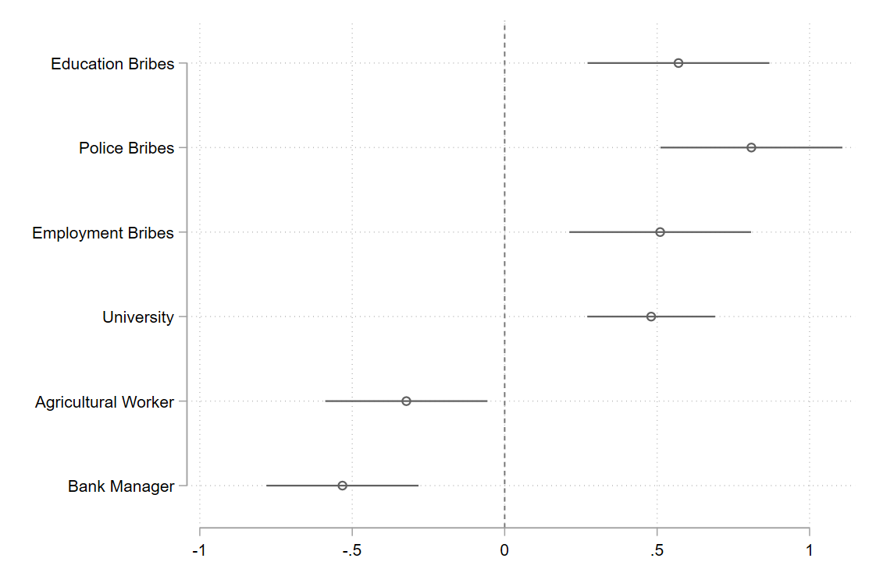
Vignette Experiment Example: Corruption and Emigration in Kenya

Slide 13
Natural Experiments
Find a ‘natural’ process which randomises who receives a treatment
Compare the ‘treated’ units with the ‘control’ units
For example Yanagizawa-Drott (2014) studied the effect on subsequent violence of an anti-Tutsi radio station in Rwanda before the 1994 genocide
Radio reception was randomly distributed according to topography

Slide 14
Natural Experiments
The Radio Télévision Libre des Mille Collines was responsible for 10% of the violence in the Rwandan genocide

Slide 15
Problems with Experiments
Generalisability from convenience samples
Realism of experimental treatments
Narrow range of questions that can be answered
Too many micro-studies
Very few true natural experiments
Focus on theory-testing rather than theory-building

Slide 16
Conclusion
Experiments are a powerful method for uncovering causal explanations in political research
They come in many flavours: lab, field, survey and natural
Randomisation is key to a good experiment
Experiments are difficult to design and only suitable for certain research topics/contexts

